Slide 1
ONYE’S DAY
The little alien that created civilization

Slide 2
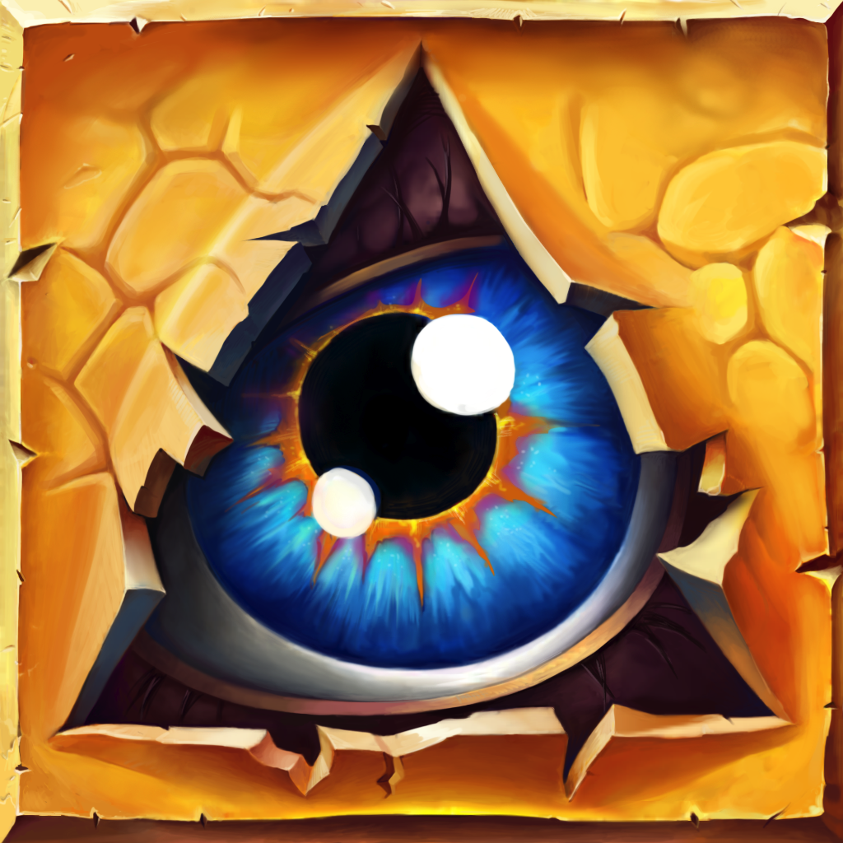
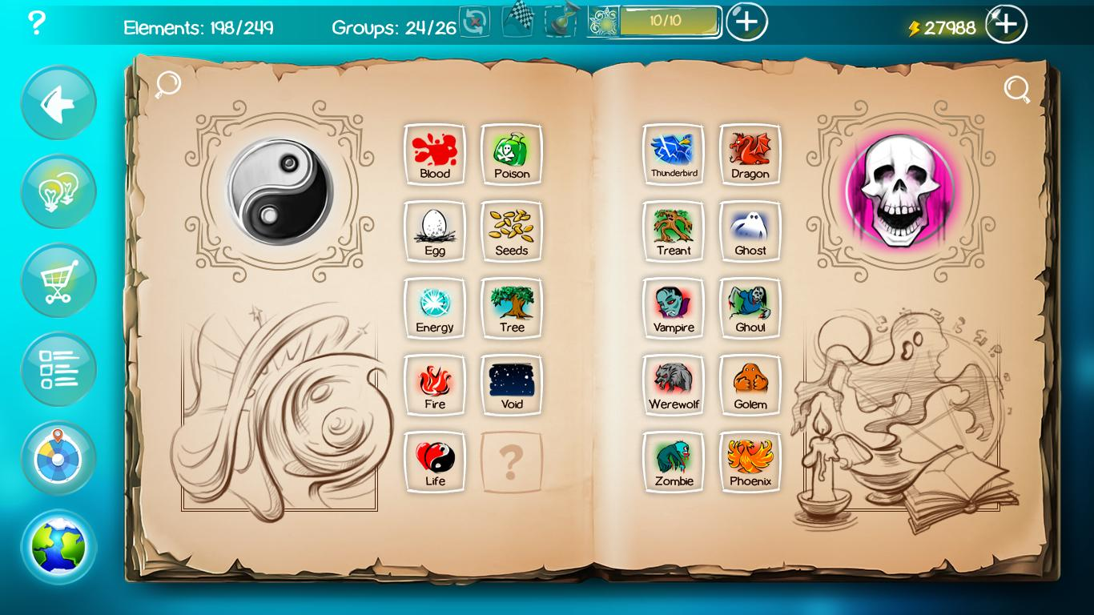
Main Inspiration
Doodle God (2010)
https://www.youtube.com/watch?v=noikl6ypI5c&t=23s

Slide 3
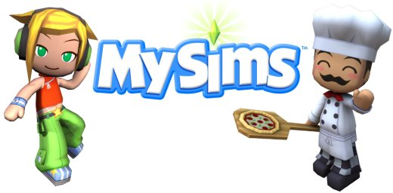
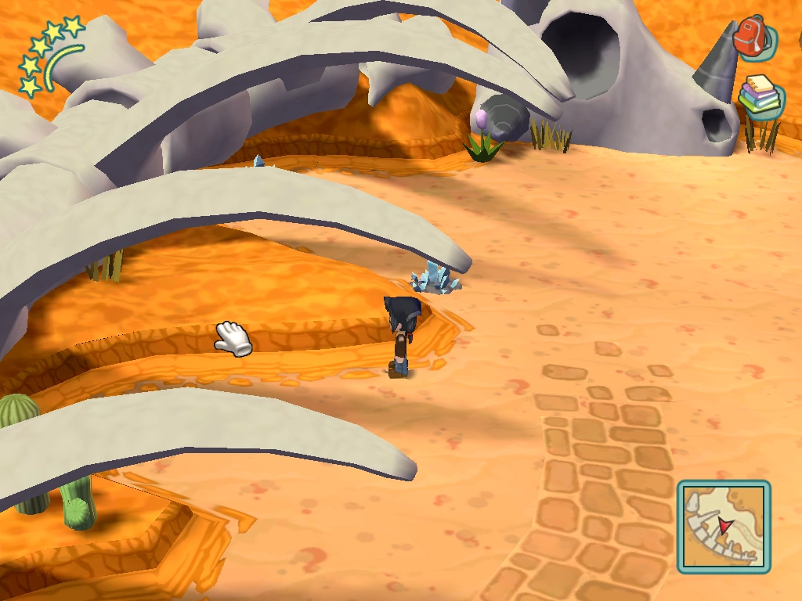
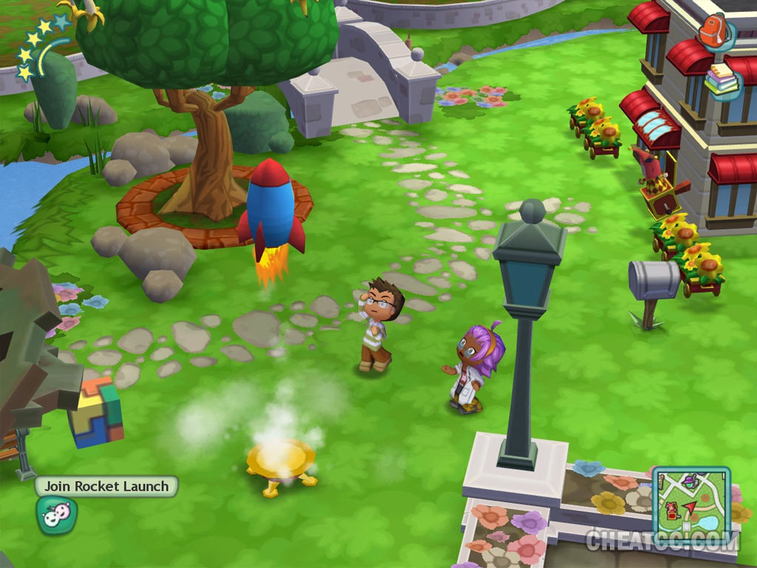
Secondary Inspiration
MySims (2007)

Slide 4
Overview
Genre : Adventure/Narrative Puzzle
Theme : ‘God Game’ like
Play Value : Slow-paced, challenging, esthetically pleasing
What’s unique : Puzzle aspect combined with physical actions in a three dimension world
Game Engine : 3D Unity
Platform : PC
Controls : Keyboard (arrows and spacebar)
Camera : Third Person View

Slide 5
Gameplay
Core Mechanic:
- Mixing and creating new elements
Objective :
- Activate all 5 main islands by combining
the two final elements together, stepping on
the island and do an action (lever, button, etc...)
Constraints :
- You start with four elements.
- All other islands are dependant of the human element. Therefore,
the player needs to start by unlocking this one. (There is a logical
order)

Slide 6
Narrative
Pulling away from the classical ‘God Game’ where you are God
Instead, you play as a little, unimportant alien called Onye
Onye finds himself stranded on a little piece of land
Onye, a curious alien, ends up accidentally creating Earth and civilization in one day by combining elements
Therefore, the narrative has more of a humorous than serious approach (The title emphasizes that idea)
Narrative not a big part of the game

Slide 7
Thought Process
Hesitating between three goals;
- You are creating and that’s it. The goal is to discover every possible combination and have fun.
- The game starts by giving you one task: create an airplane, for instance. You have to do that with fire, water, earth and air.
- You have to create a physical path with the elements which trigger new islands that you can step on in order to access something.
What about the game environment;
- When a player creates an element, does it appear automatically in a random way? Or is there a defined spot for each element?
- Or, does the player have some kind of inventory, and he decides where his island will appear? If so, would he combine two elements by placing them next to each other instead?

Slide 8
Thought Process
How does the player move Onye?
- Is the player moving the character himself, with arrows and spacebar to interact with elements?
- Or, is Onye the player’s little puppet, and the player clicks on an island and the AI moves there by itself?
How do you combine elements?
- Does the player pick up one element, and needs to go to the other and press a button to simply combine?
- Or, does he need to pick up both, and go back to the center to put them in some kind of machine? Possibly unecessarily long.

Slide 9
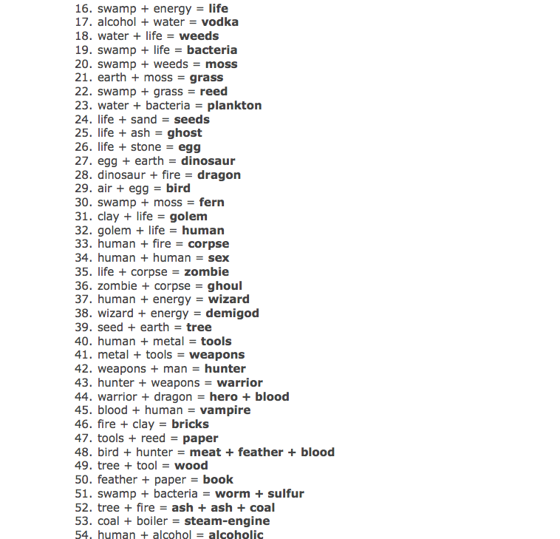
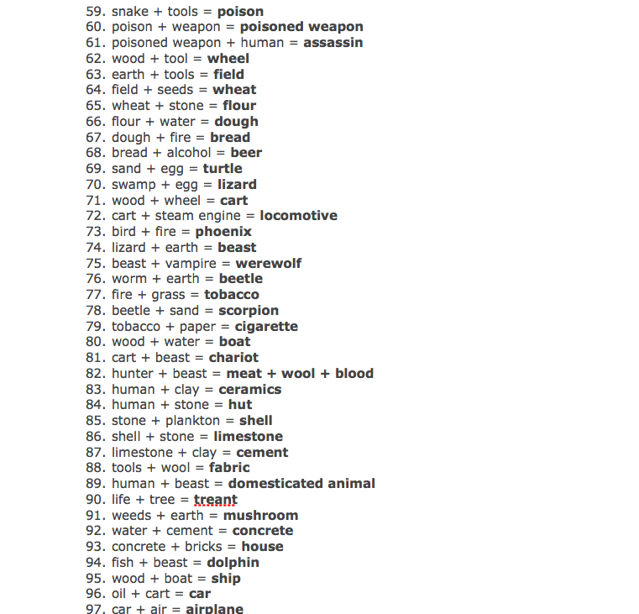
Building the World
1. Eliminate combinations (106)

Slide 10
Building the World
2. Make a visual schema
More combinations are added later on.

Slide 11
Building the World
3. Integrating final combinations into game environment
(next slide)

Slide 13
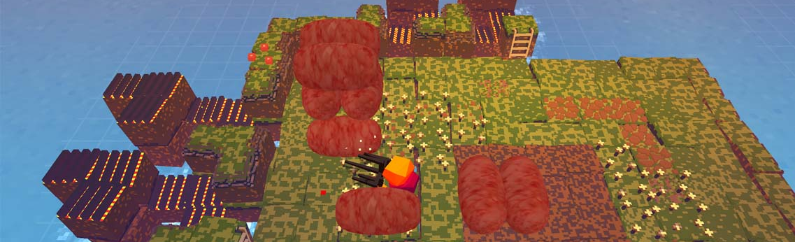
Visual Inspiration (Animations)
Stephen’s Sausage Roll
https://www.youtube.com/watch?v=6dsQtBHk0eE

Slide 14
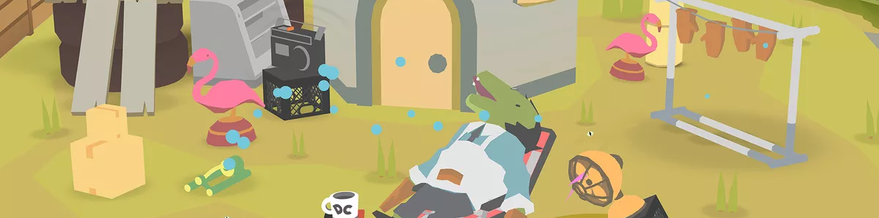

Visual Inspiration (Graphic Style)
Donut County

Slide 15
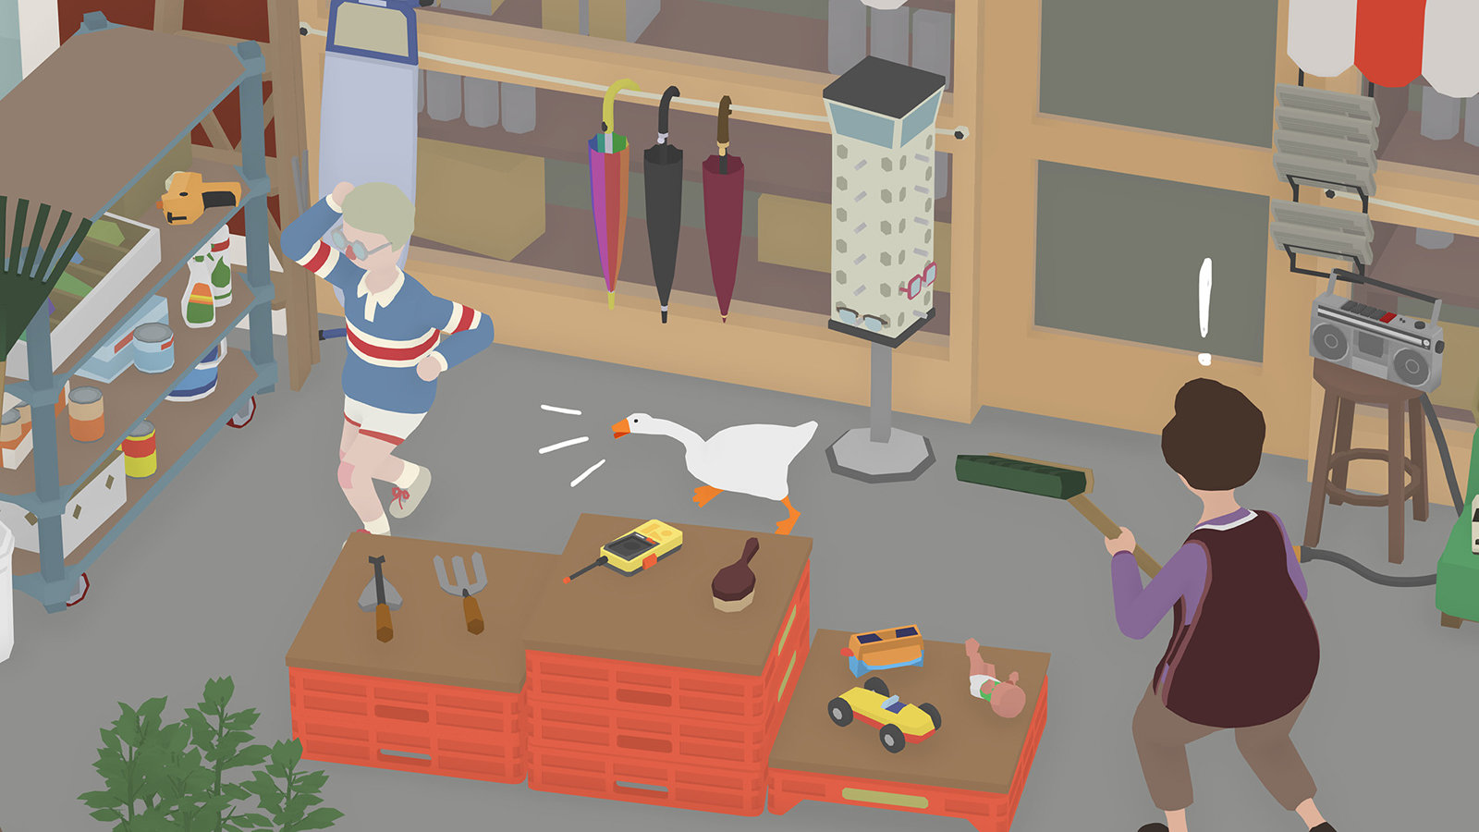
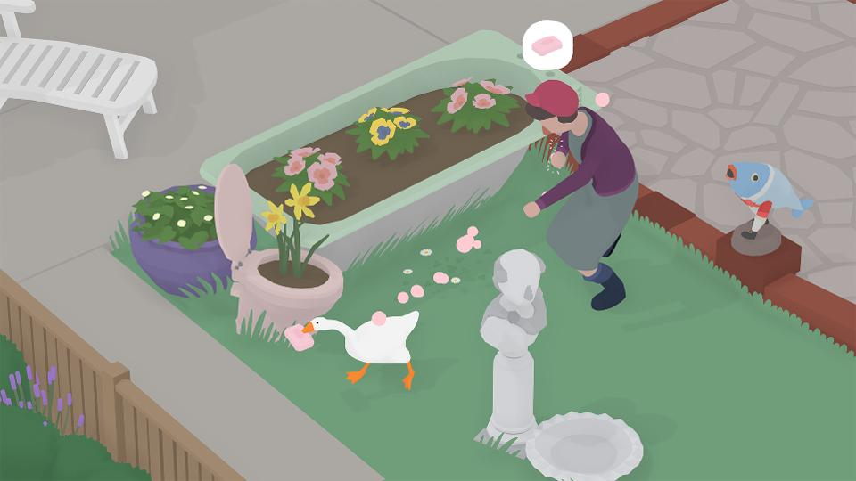
Visual Inspiration (Graphic Style)
Untitled Goose Game

Slide 16
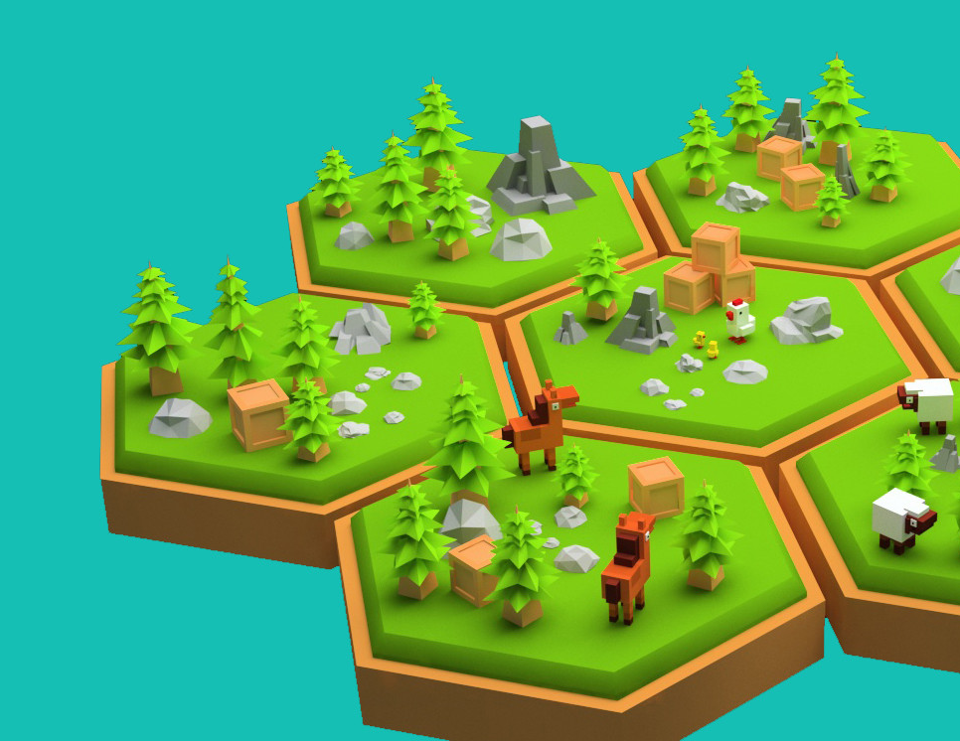
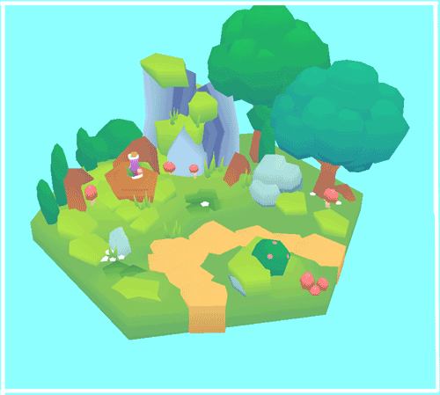
Visual Inspiration (World Structure)

Slide 17
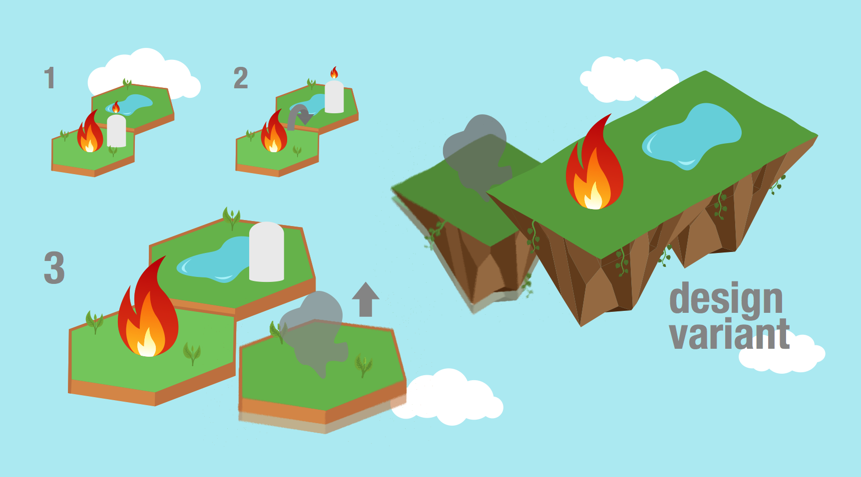
Sketches (World Structure)

Slide 18
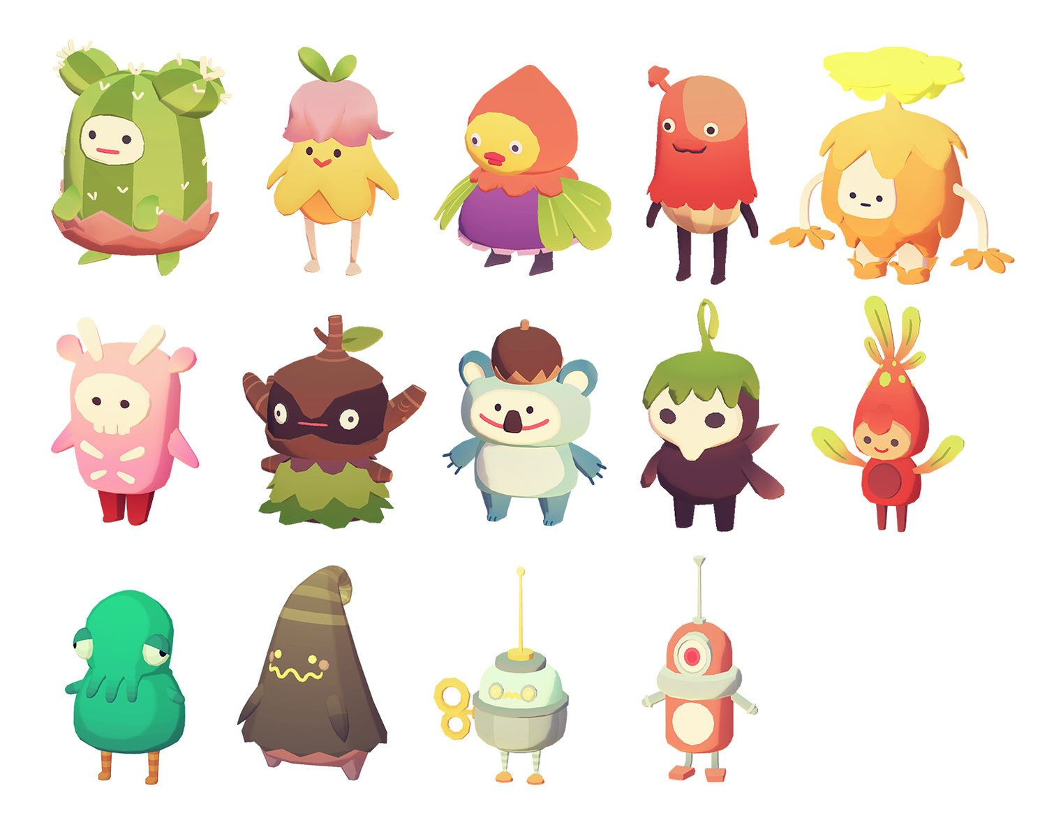
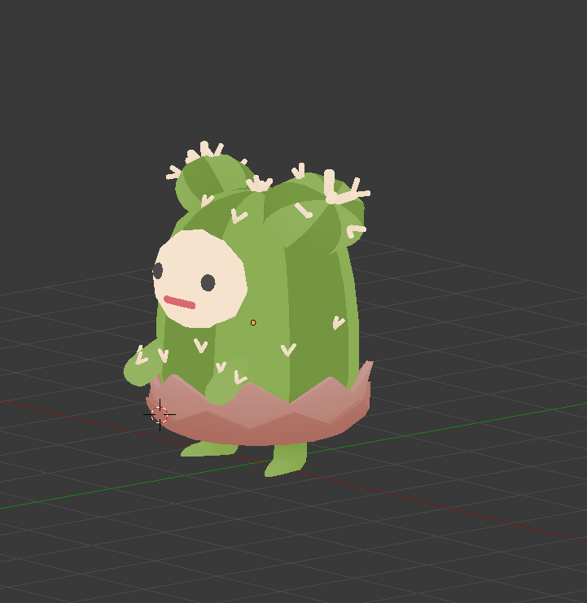
Visual Inspiration (Character)
Ooblets

Slide 19
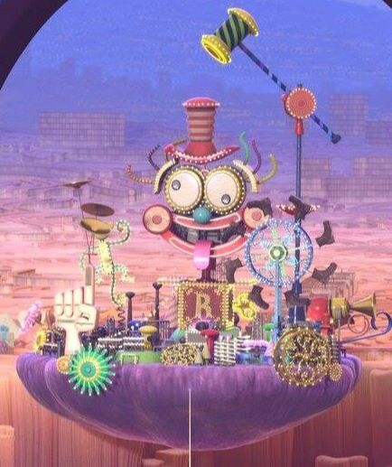
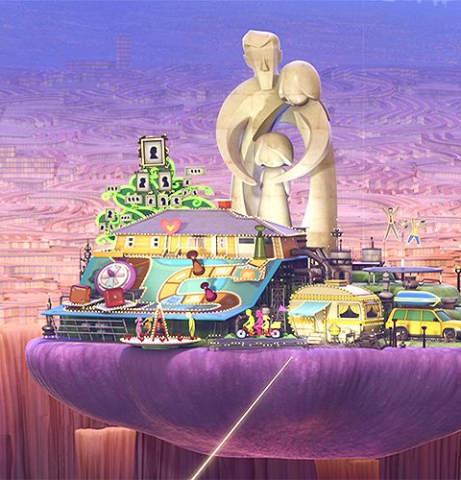
Visual Inspiration (Islands)
Inside Out (Movie)

